Slide 1

Code
Walkthrough
- AI Recycling

Slide 2

AGENDA
Introduction
Code
MLFlow
HPC Automation (demo)
Training Automation

Slide 3
Introduction
  Efficient AI Recycling
  Classify objects and gather data
    Soft drink cans
    Milk jugs
    Product-specific materials
  Sort materials with a robotic arm
  Cloud based solutions
    Video capture uploaded to cloud
    Classification on cloud
    Transfer learning

Slide 4
Code
YoloV5
Anticipate common questions
Rehearse your responses

Slide 5
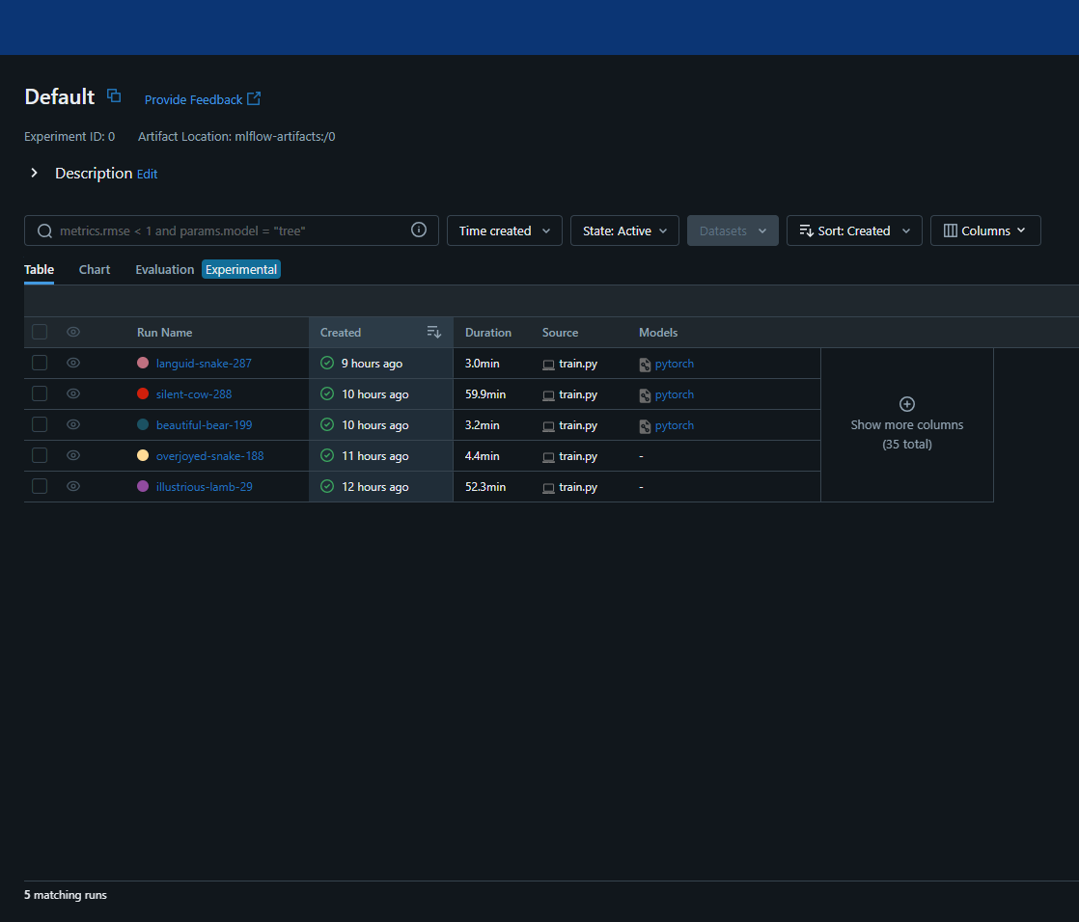
MLFlow
Experiment Tracking
Model Packaging
Model Registry
Deployment Flexibility
Our MLFlow
Notes:
Experiment Tracking: MLflow provides a centralized platform to track experiments, including parameters, code versions, metrics, and output files, allowing for easy comparison and reproducibility.
Model Packaging: It offers a standardized format for packaging machine learning models, making it simple to deploy models across different environments such as cloud platforms, edge devices, or other frameworks.
Model Registry: MLflow includes a model registry for managing and versioning trained models, enabling collaboration among data scientists and ensuring model lineage and governance.
Deployment Flexibility: With support for various deployment options like batch, real-time serving, and inference via REST APIs, MLflow streamlines the process of putting models into production.

Slide 6
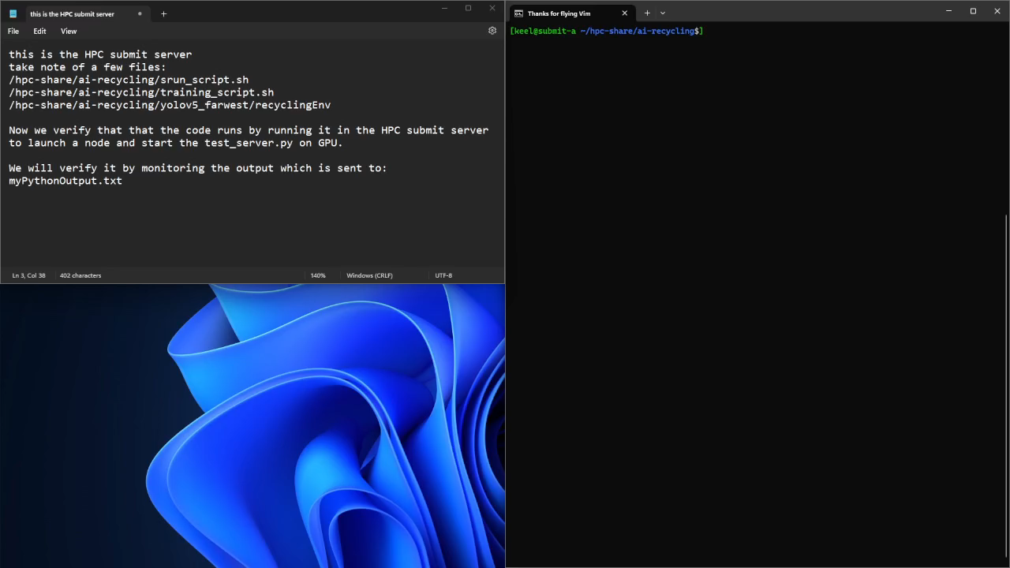
HPC Automation (demo)

Slide 7
Training Automation
Know your material in advance
Anticipate common questions
Rehearse your responses

Slide 8

THANK YOU
Brita Tamm
502-555-0152
brita@firstupconsultants.com
www.firstupconsultants.com

